Slide 1

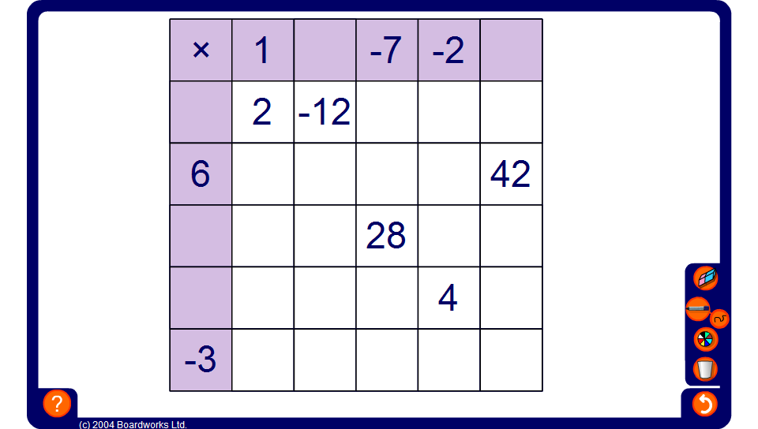


Mixed multiplication square
Notes:
Work out the numbers in the empty squares by multiplying and dividing.

